Slide 1
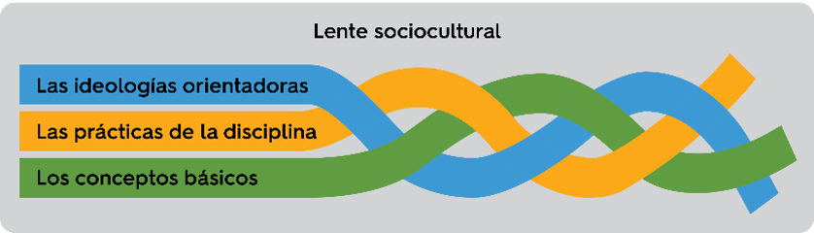
Marco ALE
WIDA's Spanish Language Arts Framework

Slide 2
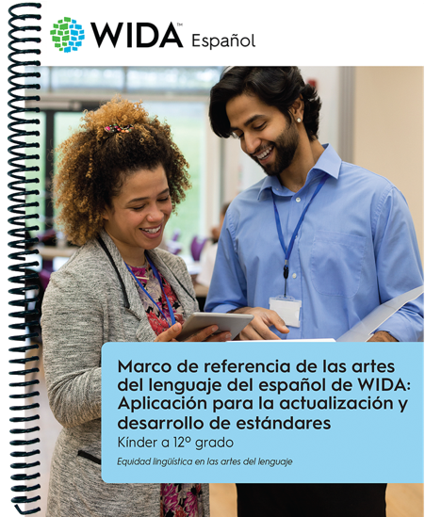
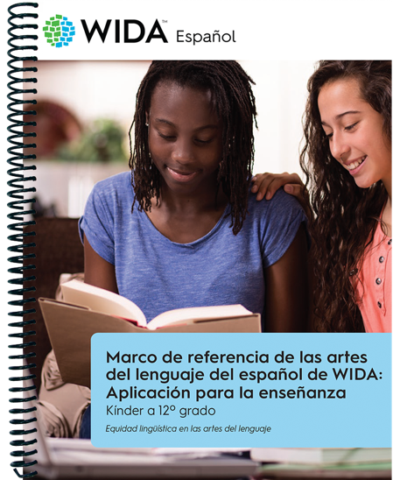
What is Marco ALE?
A framework for Spanish language arts standards and instruction
WIDA designed Marco ALE with two applications in mind:
  For administrators and policy makers: Aplicación para la actualización y desarrollo de estándares
  For teachers and school-level personnel: Aplicación para la enseñanza

Slide 3
Why is it important for the field?
First Spanish language arts framework in the U.S.
Administrator and policy-maker resource to inform Spanish language arts standards
Teacher resource to inform Spanish language arts instruction
Resource to support Spanish instruction initiatives (including pre- and in-service teacher programs)
Opportunity for impact in the field of language arts

Slide 4
How was it developed?
Research and practice-based
Informed by literature on language arts and Spanish language arts standards from Argentina (Buenos Aires Province), Chile, Columbia, Ecuador, Mexico, and the United States (California, New York, Puerto Rico, Texas)
Teacher and student-centered
  Involved policymakers, IHEs, teachers, SEA/LEAs, WIDA experts
Bi/multilingual realities of Spanish-learners in the context of the U.S. and the local context of teaching and learning Spanish language arts

Slide 5
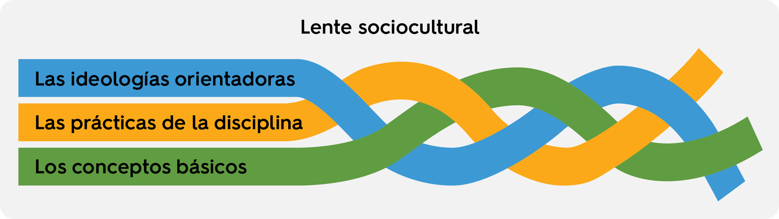
The components of Marco ALE
La trenza del Marco ALE

Slide 6
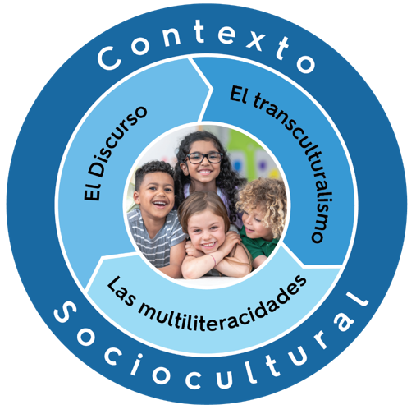
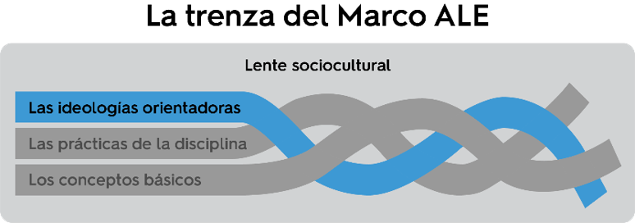
Las ideologías orientadoras
These are core ideas to guide the development of standards and instruction that leverage local values and fulfill the development of skills that empower students to participate in their local and global communities with opportunities to transform their surroundings.

Slide 7
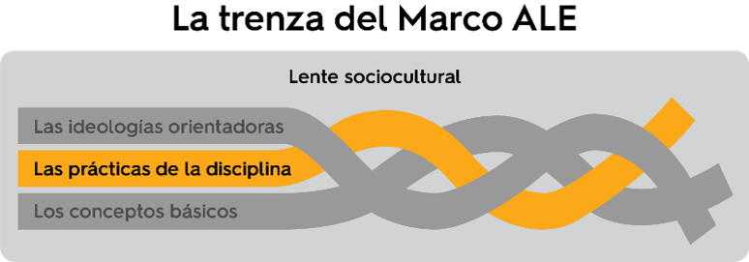
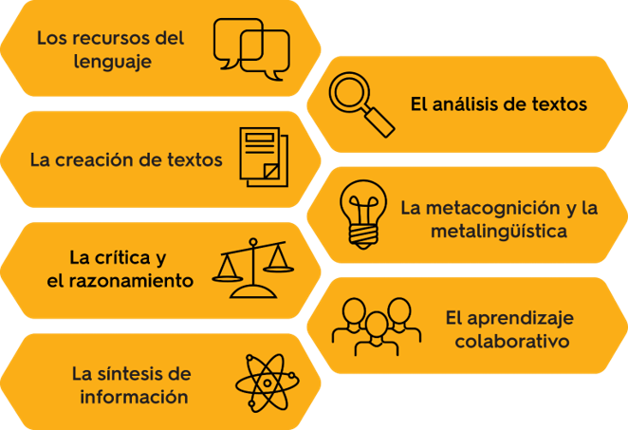
Las prácticas de la disciplina​
These represent the intersection of knowledge, experiences and content skills (in this case, of language arts), fused with the ability to read, write, listen, speak, think critically and perform meaningfully within the context of the given field.

Slide 8
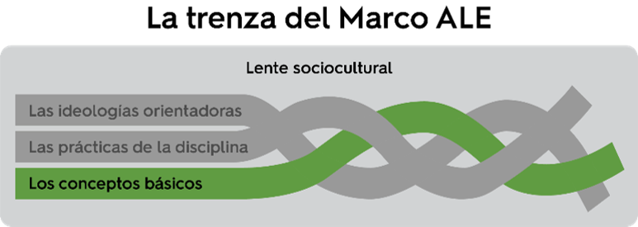
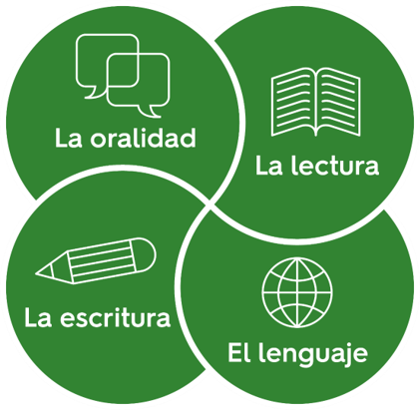
Los conceptos básicos
In this framework, conceptos básicos refers to the Spanish language academic areas, which include la oralidad, la lectura, la escritura and el lenguaje (orality, reading, writing and language).

Slide 9
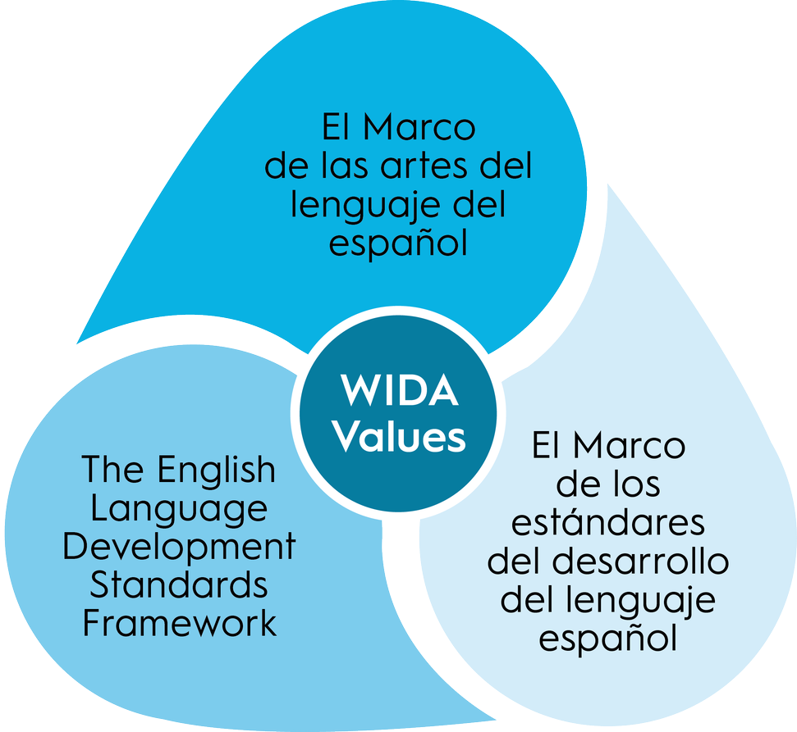
Connections to Other WIDA products
Interconnectivity to WIDA products and services
  All grounded on WIDA Values
Connections to the ELD Standards Framework, 2020 Edition
Connections to 2013 SLD Standards and forthcoming SLD Standards Framework (Marco DALE)

Slide 10
Where can you download or purchase Marco ALE documents?

Slide 11
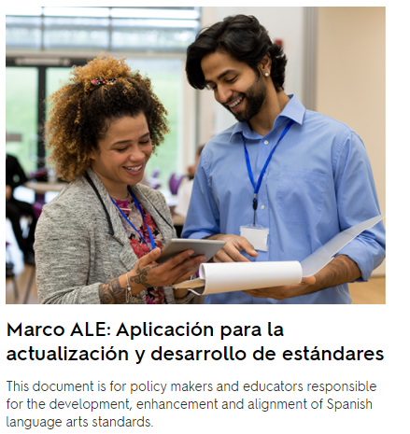
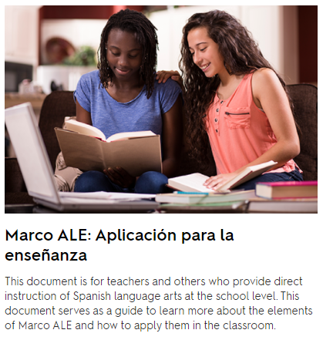
Free versions at wida.wisc.edu/MarcoALE
Sample Document

Slide 12

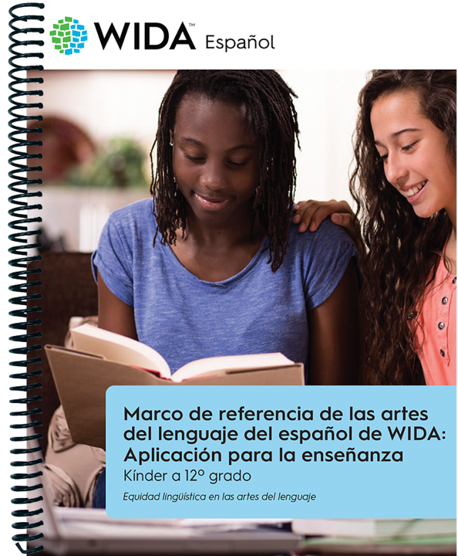
Spiral-bound, paper versions at the WIDA Store
Full-Length Document

Slide 13
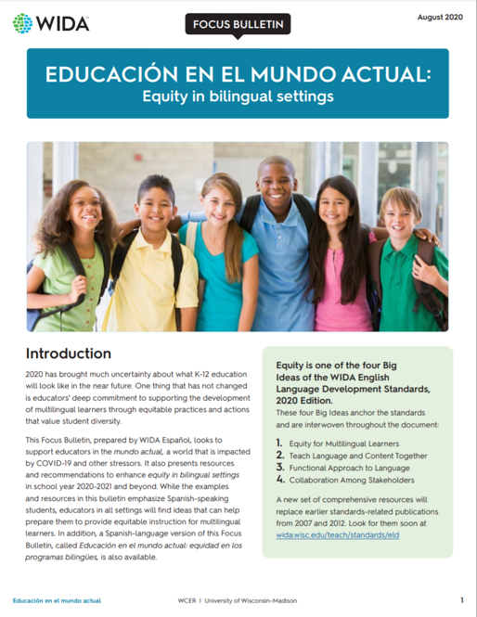
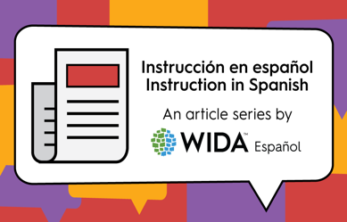
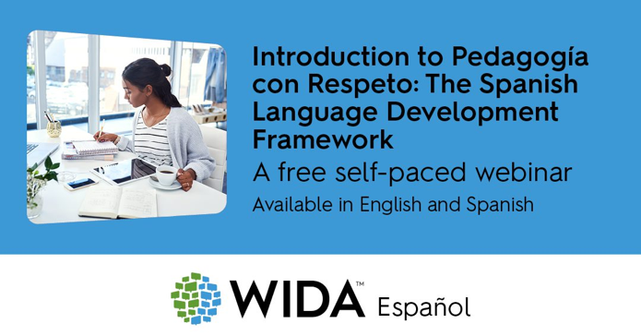
Additional resources for educators
Instruction in Spanish/ Instrucción en español Article Series
Focus Bulletins
Professional Learning opportunities for educators working with Spanish language programs

Slide 14

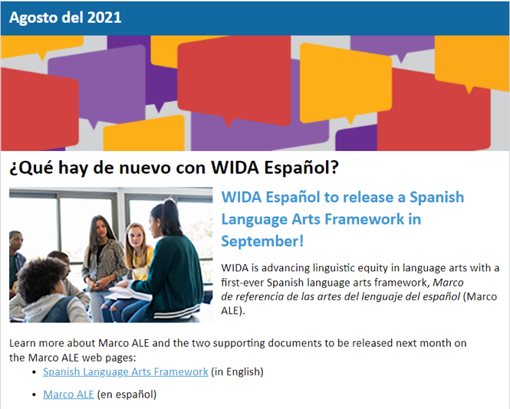

A newsletter designed for educators of Spanish instruction and Spanish-English bilingual education programs
Subscribe ​
today!
Notes:
WIDA Español News is a newsletter to support educators working with bi/multilingual learners in Spanish-English bilingual settings.

Slide 15
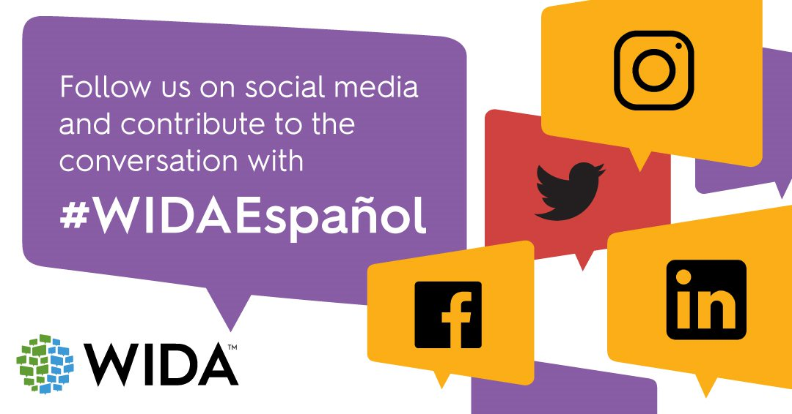
Contact us at: espanol@wida.us

