Slide 1
Marco de los estándares del desarrollo auténtico del lenguaje español de WIDA (Marco DALE)
Notes:
Suggested script
Welcome and thank you for joining this presentation on Marco DALE, that’s Marco de los estándares del desarrollo auténtico del lenguaje español de WIDA. Marco DALE is a Spanish language development standards framework that was released in 2023. This presentation will cover the major elements of Marco DALE, its connections to other language frameworks produced by WIDA, and its uses to inform classroom and program level decisions.

Slide 2
Session Overview
Purpose and Development of Marco DALE
Connections to WIDA Language Frameworks
Contents of Marco DALE
Resources to Implement Marco DALE
Notes:
Suggested script
During our time together, we will cover the following topics under Marco DALE: it’s purpose and development, its connections to other WIDA Language Frameworks, its contents, and resources to support its implementation.

Slide 3
Marco de los estándares del desarrollo auténtico del lenguaje español de WIDA
Marco DALE
Notes:
Suggested script
Marco DALE is the acronym for the full length title of this work: Marco de los estándares del desarrollo auténtico del lenguaje español de WIDA. You’ll notice that this is a standards framework, a “Marco de los estándares.” This is captured by the leading word “Marco” in the acronym. We draw DALE from “desarrollo auténtico del lenguaje español.” Unlike other Spanish language development standards, Marco DALE is unique in that it was originally constructed for Spanish from Spanish. Marco DALE is not a translation or transadaptation of English language development standards. The authenticity of this language development standards framework comes across in its components and ensures that educators are well equipped for guiding the Spanish language development of their bi/multilingual learners.

Slide 4
Purpose and Development of
Marco DALE
Guides Spanish language development of curriculum, instruction, professional learning and assessments
Informs policy and program level decisions
Incorporates recent research and innovations in the field of language learning and education in Spanish
Leverages other WIDA language frameworks
Notes:
Suggested script
Marco DALE was developed to

Slide 5
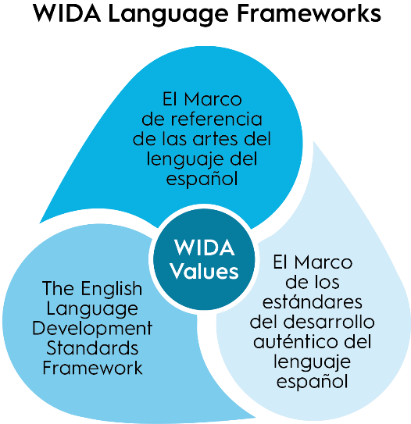
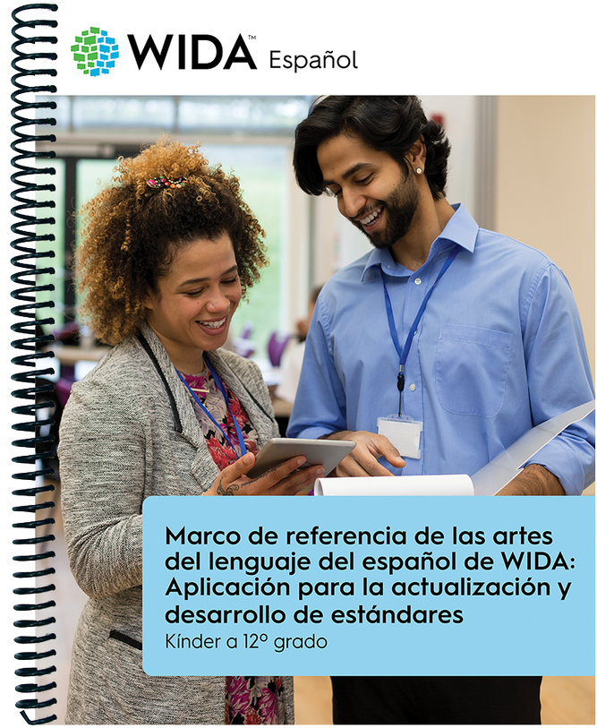

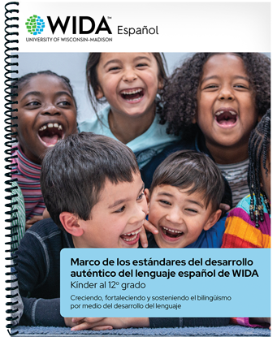
Connections to WIDA Language Frameworks
Notes:
Suggested script

Slide 6
Contents of Marco DALE
Notes:
Suggested script

Slide 7
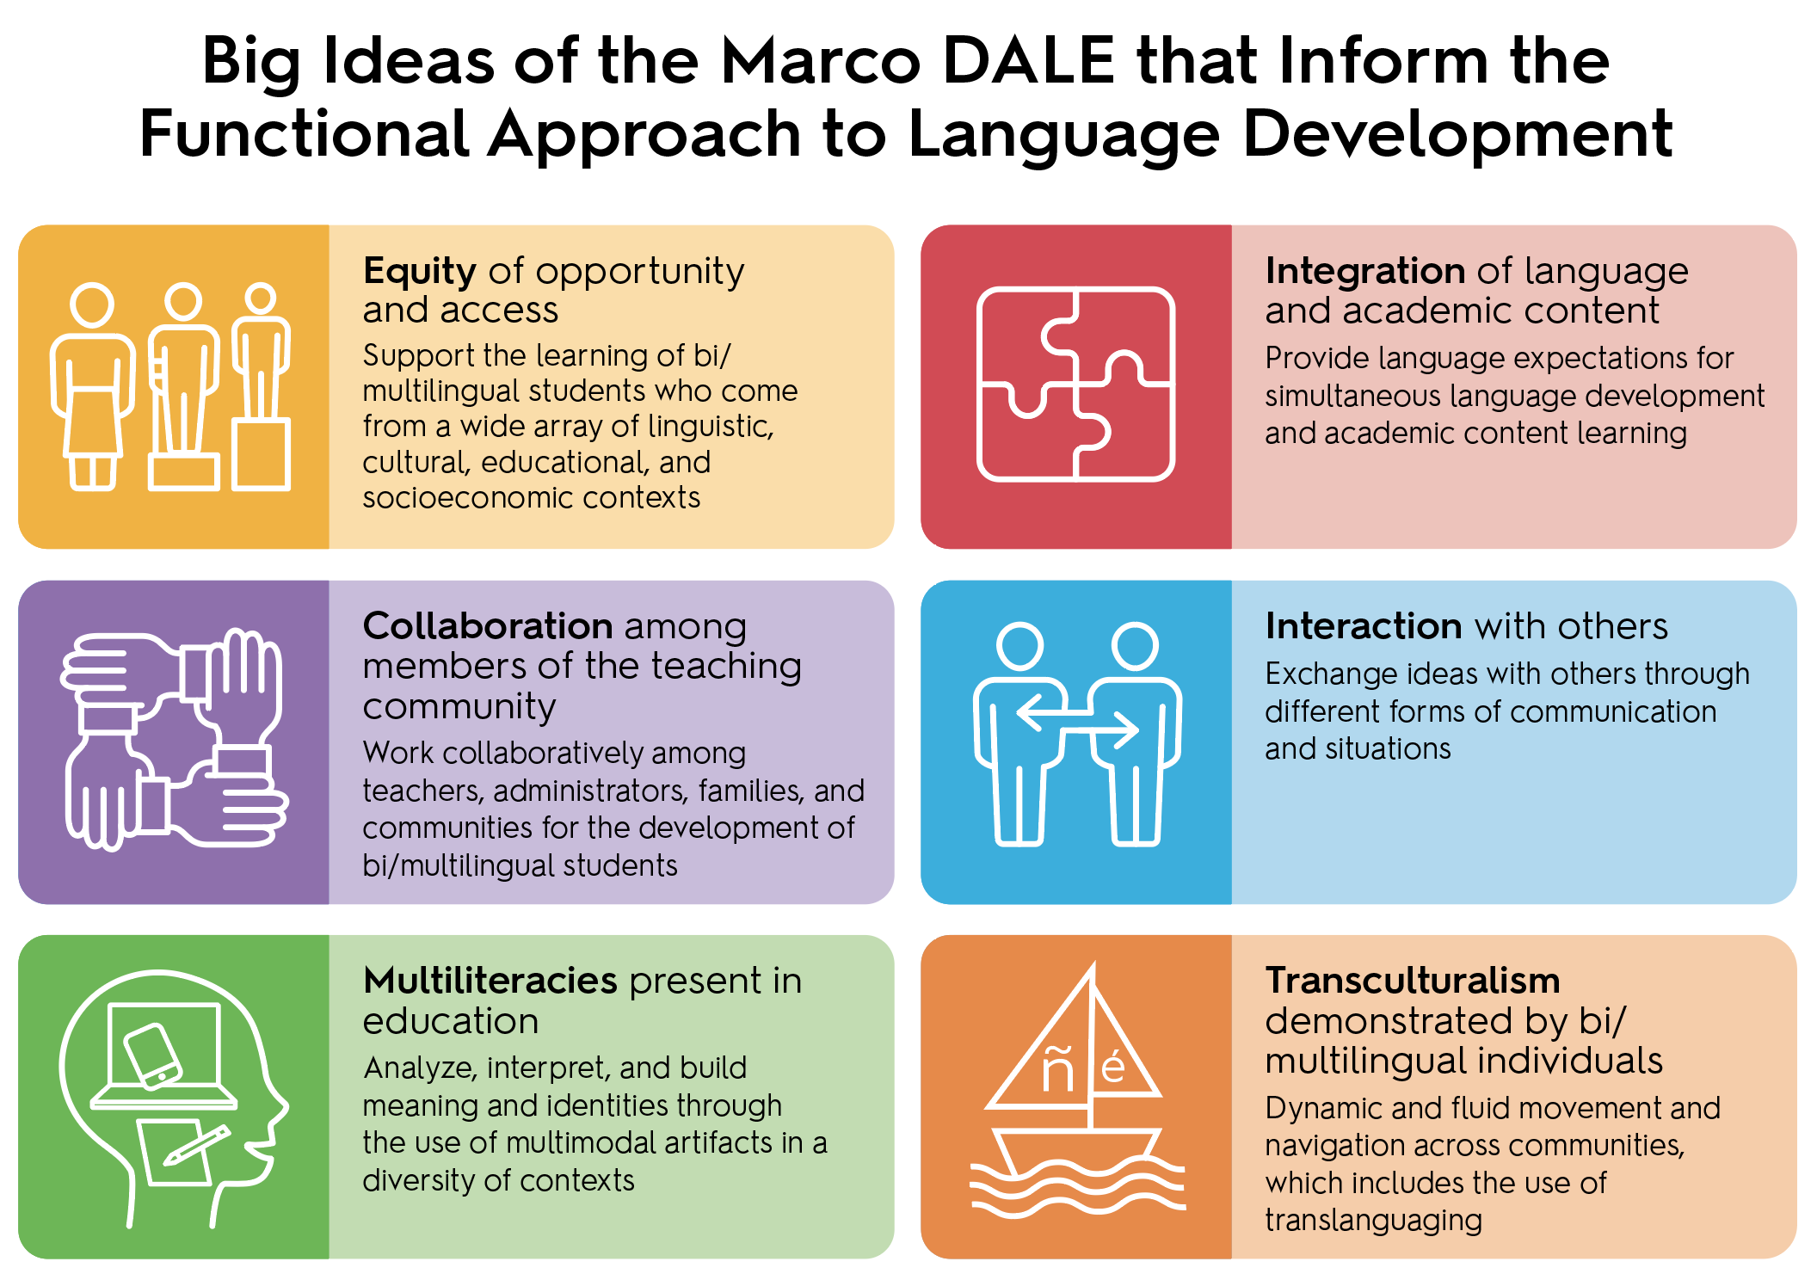
Notes:
Suggested script

Slide 8
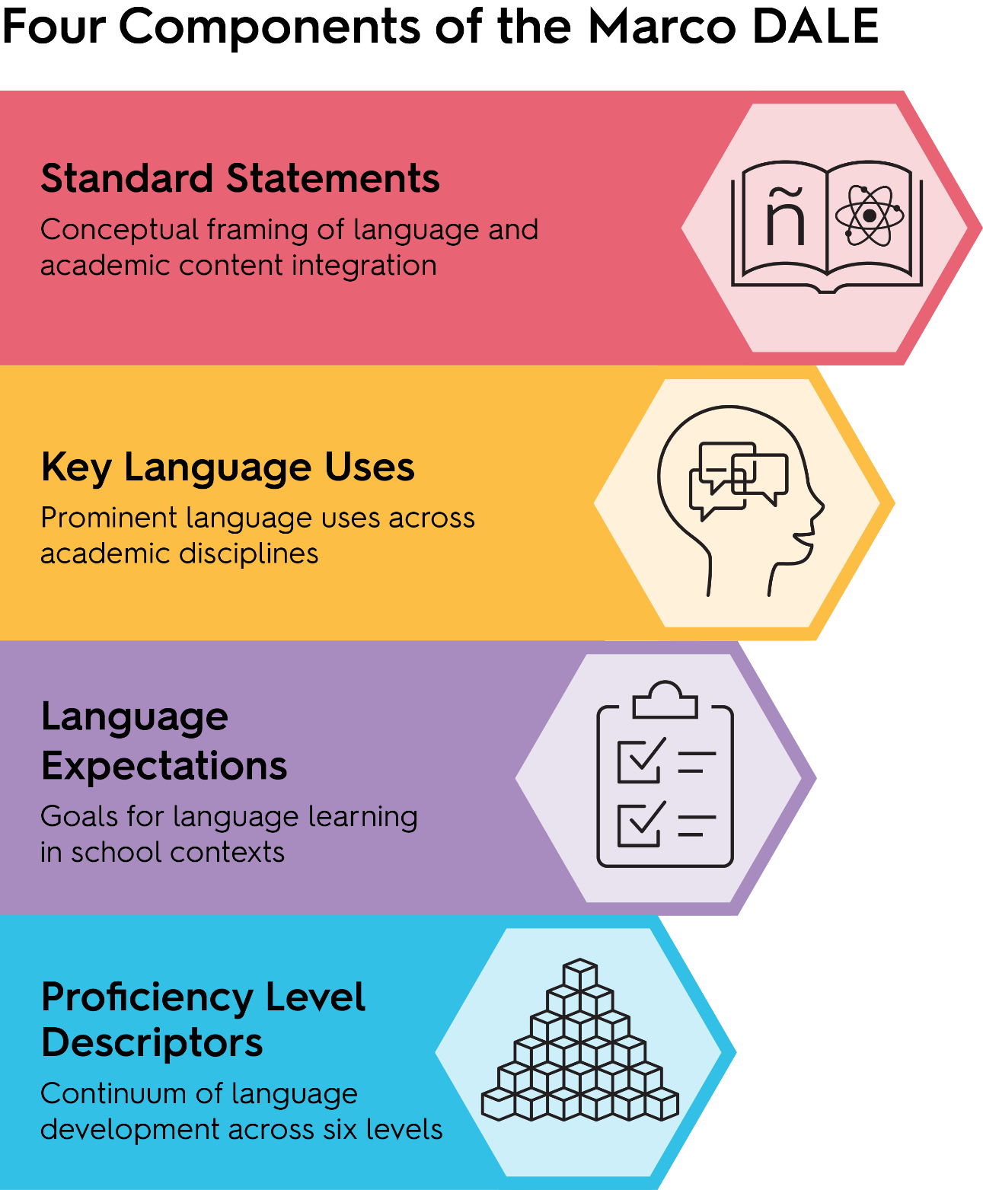
Notes:
Suggested script

Slide 9

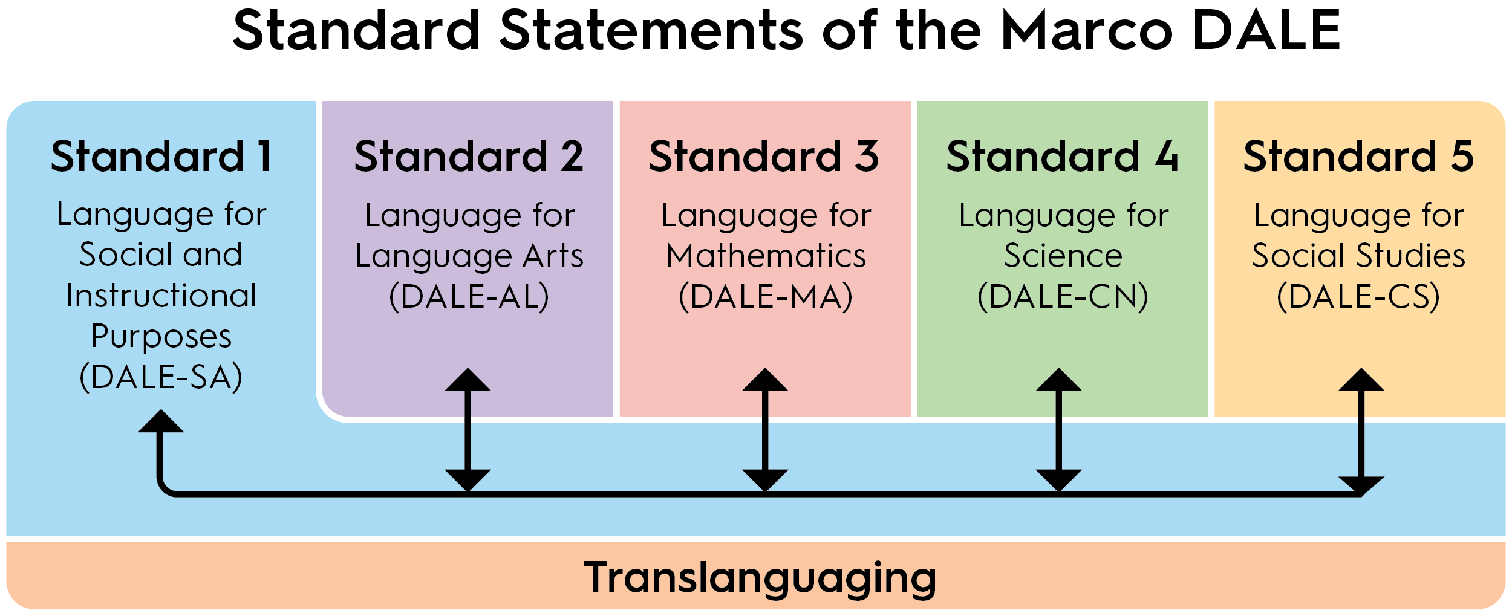
Notes:
Suggested script

Slide 10
The Marco DALE Standard Statements…
Cover the language for social and instructional purposes (Standard 1), which comes across all standards
Cover the language for each of the four common academic content areas (Standards 2-5): Language Arts, Mathematics, Science, and Social Studies
Maintain translanguaging across all standards
Are same for all grade levels K-12
Are reflected in the following grade level clusters: K, 1, 2-3, 4-5, 6-8, and 9-12
Notes:
Suggested script

Slide 11
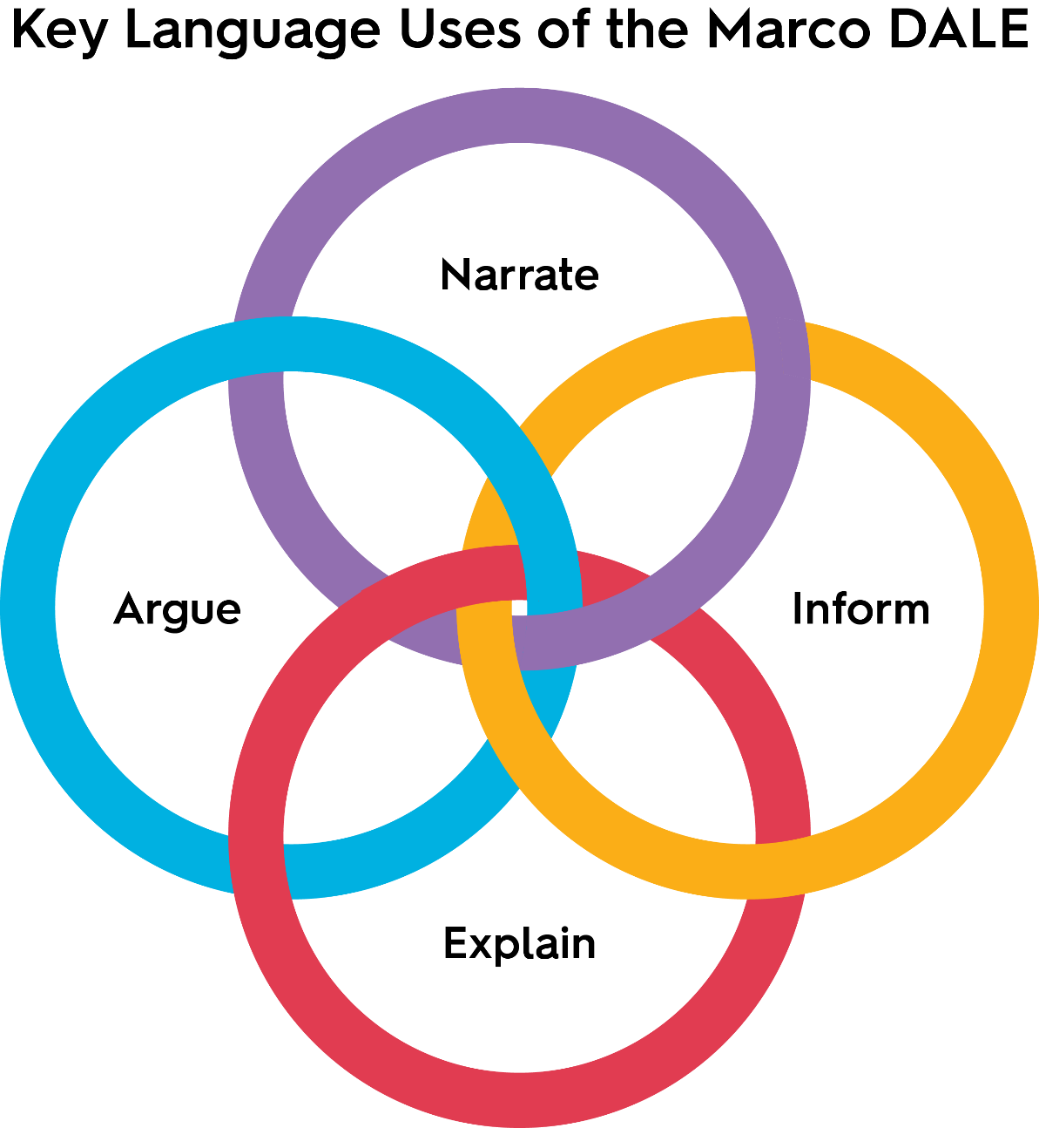
Notes:
Suggested script

Slide 12
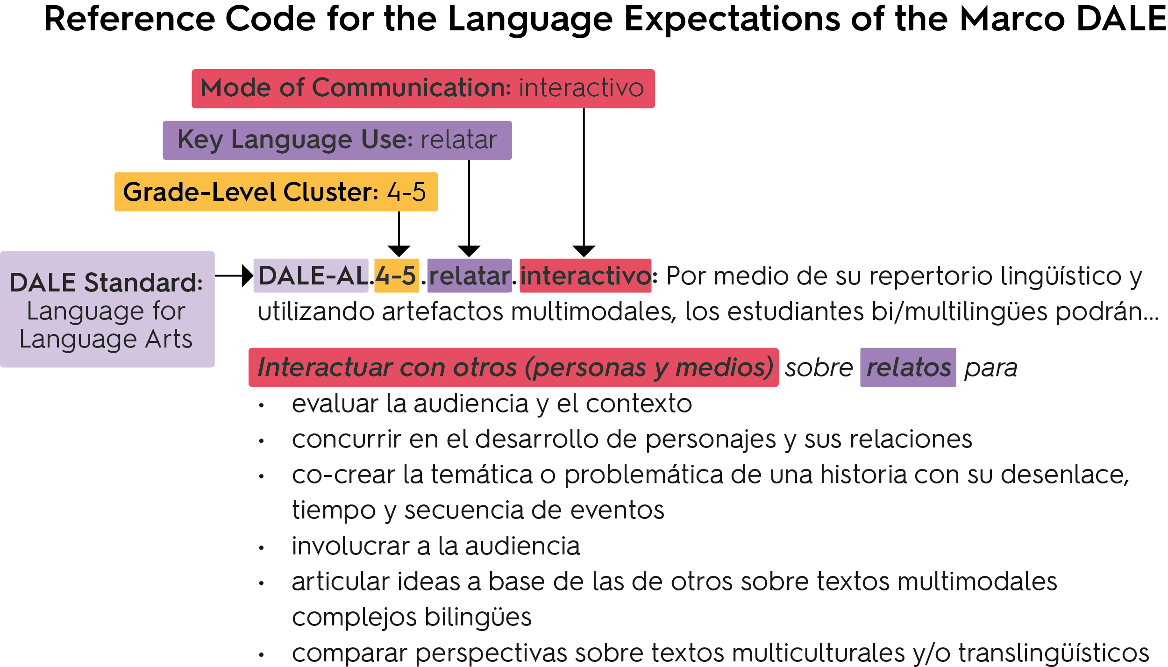
Notes:
Suggested script

Slide 13
Notes:
Suggested script

Slide 14
Notes:
Suggested script

Slide 15
Notes:
Suggested script

Slide 16
Notes:
Suggested script

Slide 17
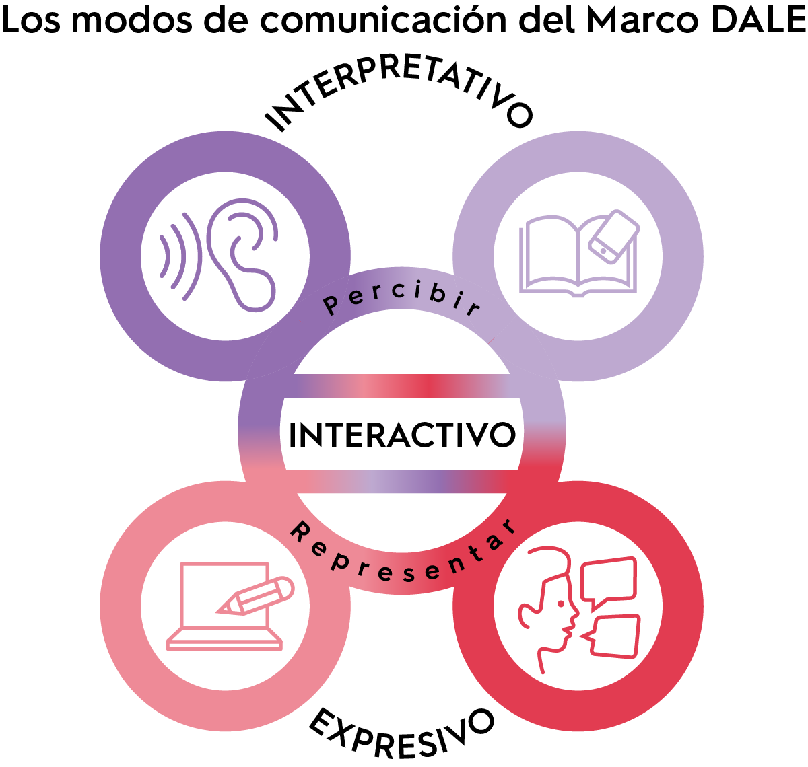
Notes:
Suggested script

Slide 18
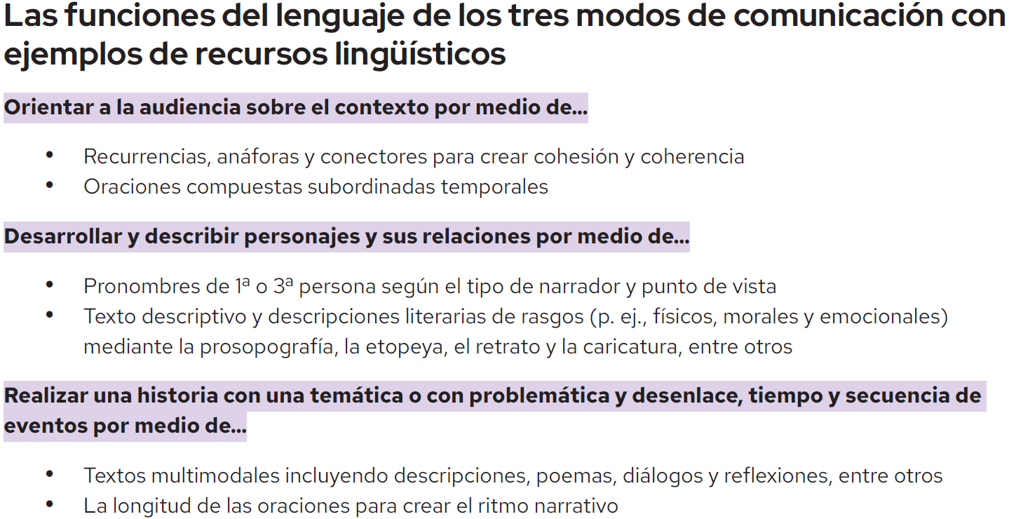
Notes:
Suggested script

Slide 19
The Marco DALE Proficiency Level Descriptors…
Provide a general guide of Spanish language development across six levels of proficiency
Are organized by mode of communication and language dimensions (discourse, sentence, and word/phrase)
Allow for educators to design instruction and assessments to track students over the course of the six levels of language development — but should not be used to dictate grades or make decisions on bi/multilingual learners’ cognitive abilities
Are presented in Marco DALE for Kindergarten and Grade 1 and for Grades 2-12
Notes:
Suggested script

Slide 20
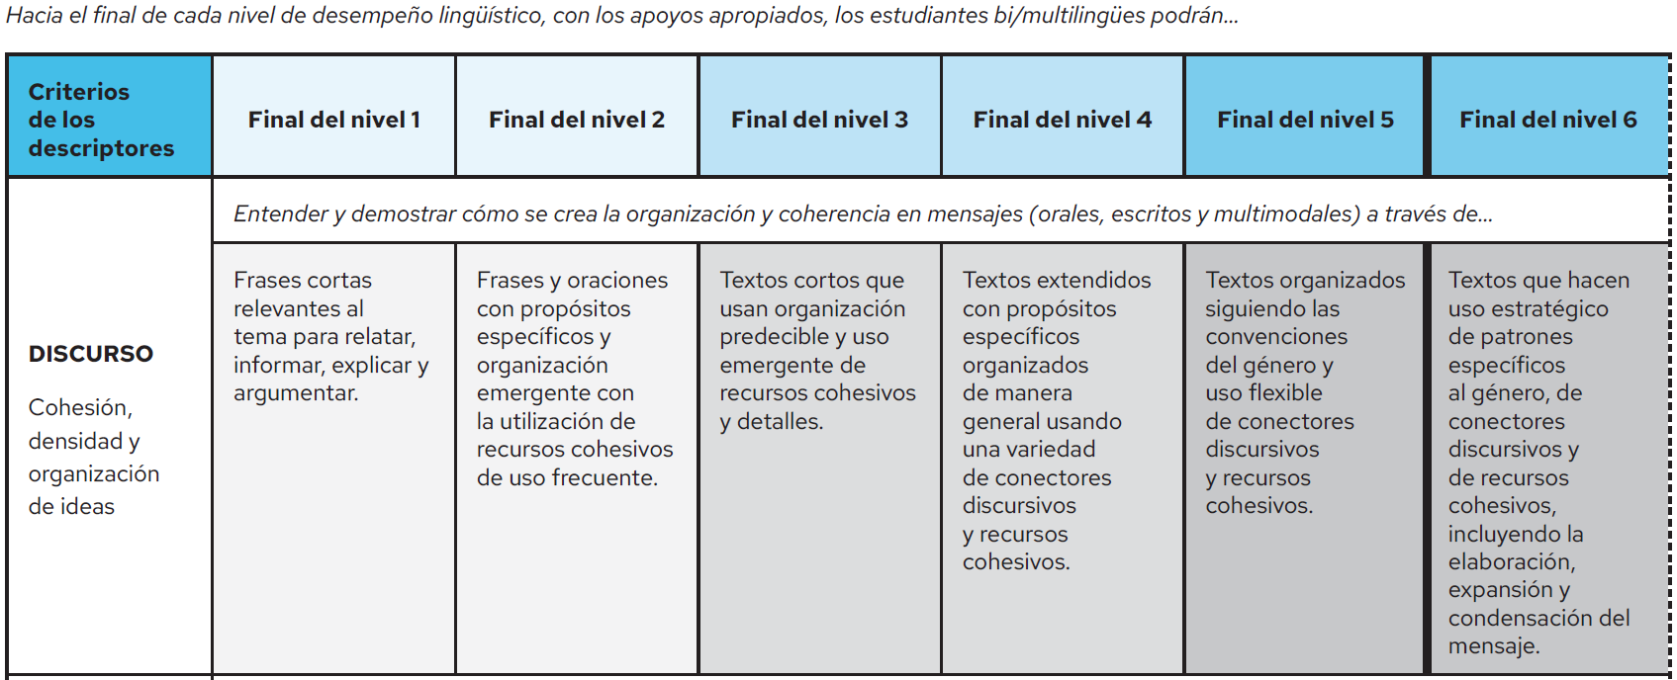
Notes:
Suggested script

Slide 21
Resources to Implement
Marco DALE
Notes:
Suggested script

Slide 22

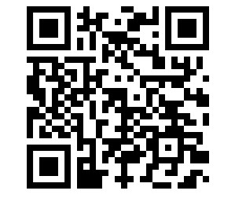
Marco DALE
Marco de los estándares del desarrollo auténtico del lenguaje español de WIDA
Get your copy today!
wida.wisc.edu/MarcoDALE​
Notes:
Suggested script

Slide 23
Marco DALE Communications
Press release
Communications toolkit
Overview slides
Flyer
*All materials are posted in English and in Spanish*
Notes:
Suggested script

Slide 24
Marco DALE Learning Opportunities
WIDA Webinar on Marco DALE
Marco DALE Professional Learning Academy
Article on the Big Ideas of Marco DALE
Focus Bulletins on translanguaging, multiliteracies, collaboration, and (forthcoming) interaction
Notes:
Suggested script

Slide 25

Contact Us
For questions and more information on Marco DALE
or other WIDA Español
products and services,
reach us via email
at espanol@wida.us

Slide 26

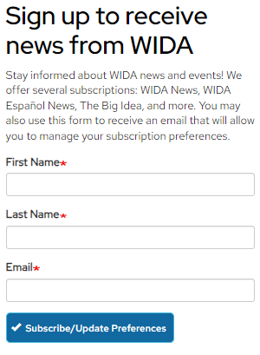

Sign up to stay up to date on all WIDA Español news!
wida.wisc.edu/news
Notes:
Suggested script

Slide 27
Notes:
Suggested script

